Slide 1

Cyclistic Rider Behavior:
Casual vs. Member
Presented by: Ishan Nichols
Last updated:
NOVEMBER 14, 2025

Slide 2
Table of Contents
Purpose Statement (What is our business goal?)
Analysis Findings
Conclusion
Recommendations

Slide 3

Identify how annual members and casual riders use bikes differently.
Objective

Slide 4
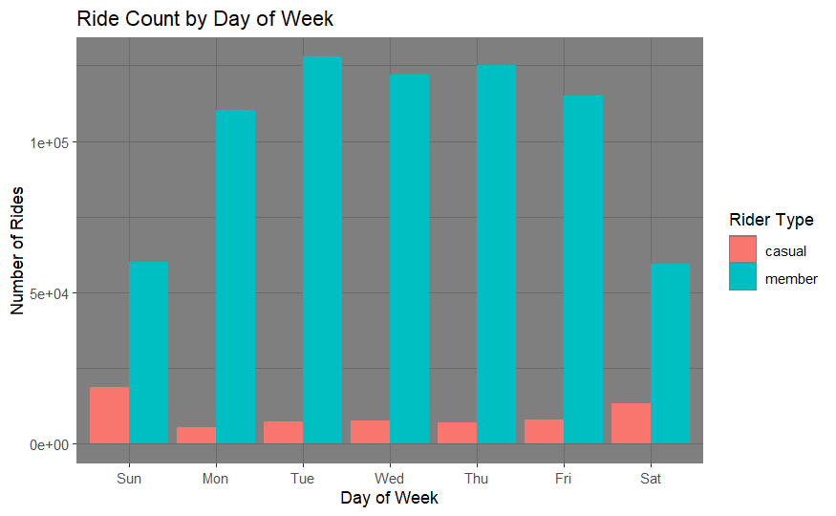
Number of Rides
Members take dramatically more rides than casuals.
Members ride the most on weekdays, while casuals ride the most on the weekend.

Slide 5
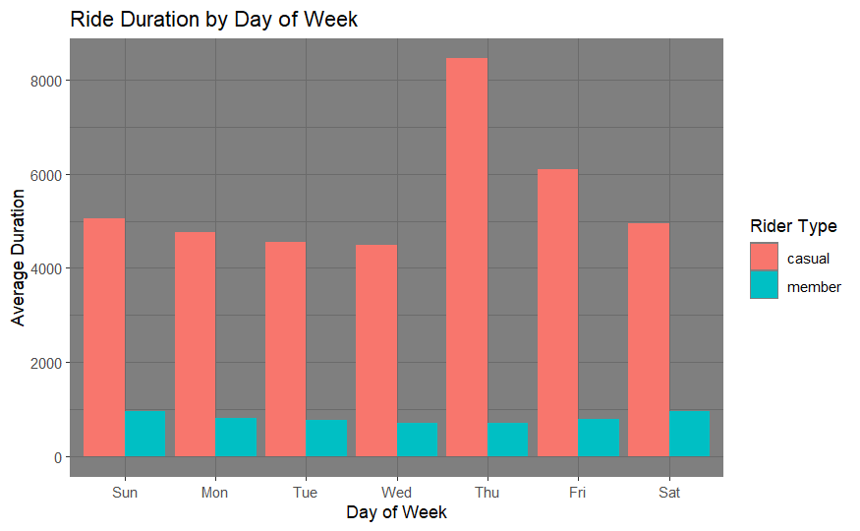
Ride
Length
Casuals ride for dramatically longer than members. (~89 mins vs. ~13 mins)
Casual riders ride for the longest on Thursday and Friday.

Slide 6
Conclusions
Member riders take significantly more rides compared to casuals but take much shorter rides than them.
Members mostly ride during the week (likely commuting), while casuals mostly ride on the weekend (leisure riding).

Slide 7
Recommendations
Tailor a campaign to casual riders by offering a membership deal with weekend and long ride benefits.
Aggressively market on Thursdays and Fridays, when casual riders are most likely to be purchasing more expensive long-distance rides.
Highlight the benefits of cycling more often to encourage more frequent riding.

